Slide 1

Life Bloom Rescue Centre’s Experience in Responding to SGBV and Women’s Economic Empowerment.
July 9th 2021

Slide 2
BACKGROUND….
Life Bloom Services International (LBSI) was legally registered in 2004 (Sept 23rd) with the NGO Coordination Board.
The program is a direct response to escalating matters Sexual and Gender Based Violence trends mainly in low income urban areas. (Curative and Preventive)
Focus on marginalized or excluded women and girls in low income urban areas.
Direct operations both in Nairobi County (Eastleigh, Mlango Kubwa areas) and Nakuru County (Naivasha and Gilgil Sub-counties) and larger Nakuru County
Our Slogan: Giving Women and Girls a Second Chance

Slide 3
Focus on forms of S&GBV.
Guided by the (UN) Palermo Protocol of 2000, LBSI focuses is on women and girls who are victims/survivors of domestic and international human trafficking and sexual exploitations.
These are the “prostituted” women and girls, sometimes referred to as women in the sex work industry.
Teen Moms are key beneficiaries too.

Slide 4
Identified needs of the women UPON ENTRY: when they knock on our doors!
Low Literacy levels
Low self esteem/levels of self confidence
Inability to provide basic needs
Inadequate of job skills
Inadequate of resources to educate the children
Self denial and rejection from society/family
Guidance on alternative way to earn a living
Looking for unconditional acceptance
Seeking for justice:
Safe space

Slide 5
ECONOMIC EMPOWERMENT
We developed a Inhouse 6 Steps Curriculum:
Vocational Skills (Hairdressing, Catering, Computer etc)
Financial Literacy Skills
Business and Marketing Skills
Life Skills and Counselling
Parenting Skills
Transformative Leadership

Slide 6
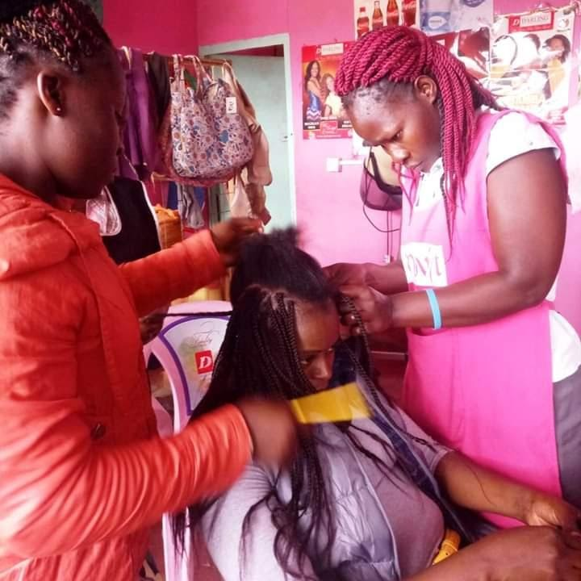
COURSES OFFERED 1.Hairdressing.

Slide 7
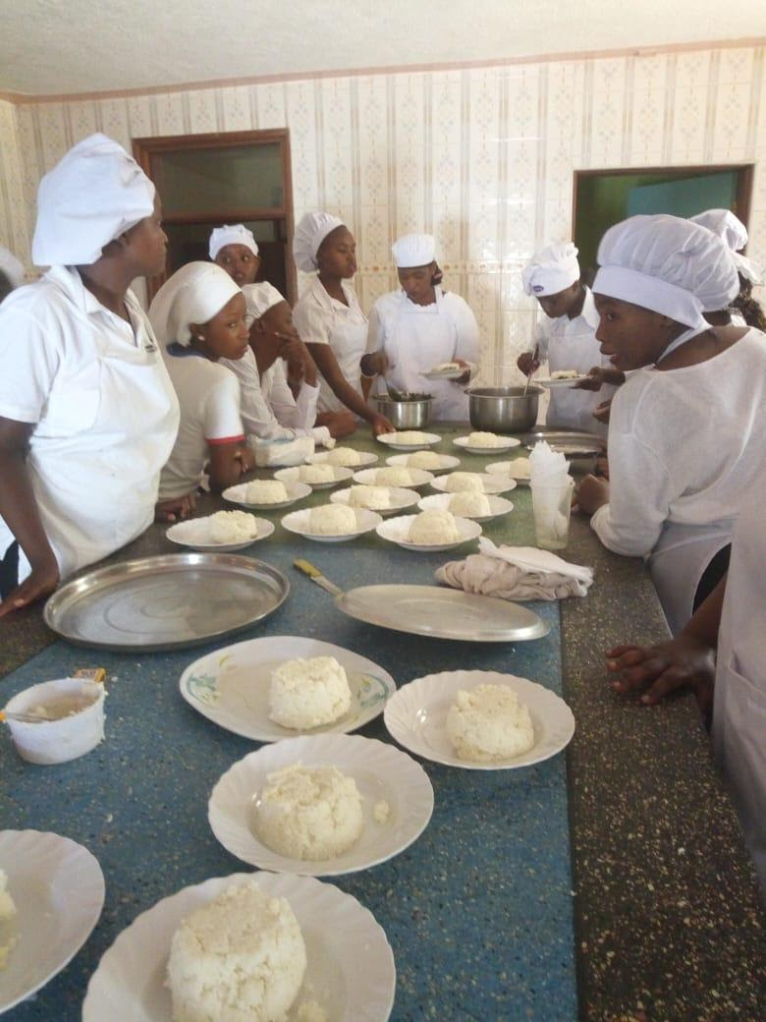
Catering.

Slide 8
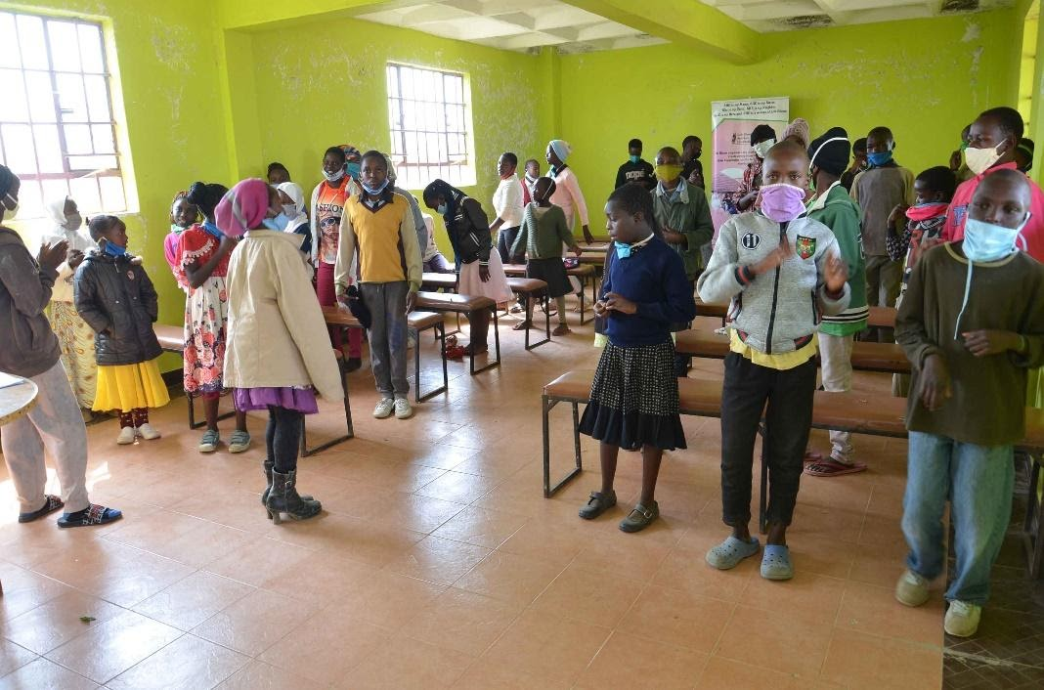
Life Skills training at the Center

Slide 9
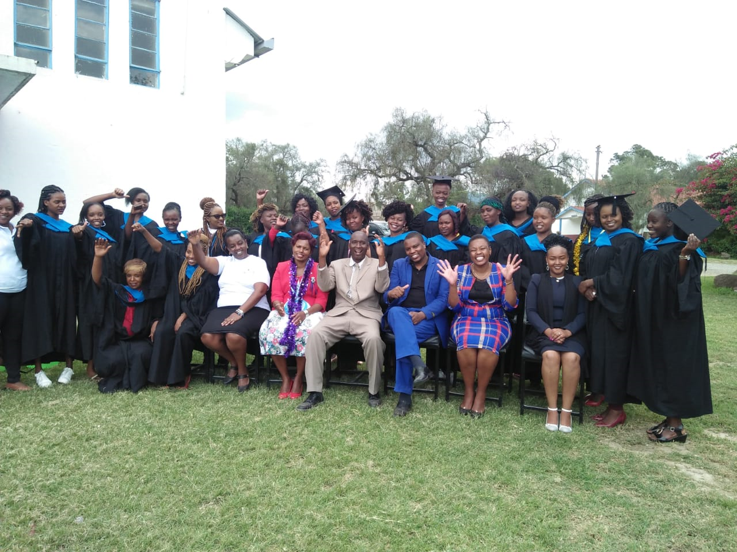
2019 graduation for 33 trainees (Naivasha)

Slide 10
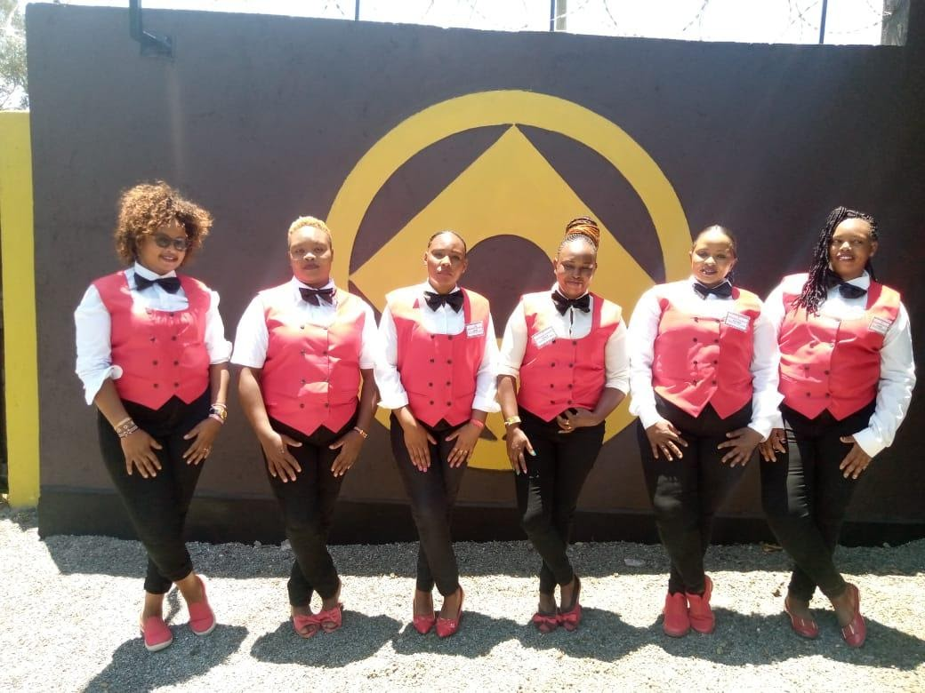
G-QUEENS Self Help Group

Slide 11
INCLUSIVITY AND SUSTAINABILITY for WEE.
1. MENTORSHIP – 25 mentors currently a) Peer Mentors (13) b) Mother Mentors/Father Mentors (12) c) Other Community Mentors/Professional Volunteers d) Women Groups (13)
2. Advocacy for Policy Inclusion (Gender and Children within Nakuru County)
3. Stakeholders engagement (Govt dept., CSO’s, Faith Based, Corporates and business entities)

Slide 12
Constraints to Women Economic Empowerment
BENEFICIARIES
ORGANIZATIONAL LEVEL
Relapse are common
Low personal Commitment:
Tied by many roles (gender)
Limitation from Cultural Barriers (to access and benefit from economic space available).
Low literacy levels.
Sometimes limited resources to start up: (opportunity are available)
Dependency syndrome (belief they have a right to be helped)
Limited residential centers for rescued women
Tested and proven curriculum for this target population.
With Covid 19 pandemic cases have increased
Inadequate resources

Slide 13
